Slide 1
Merchants, Print Providers, and Shipping Carriers Characteristics
By: Paul Rukwaro
Data Analyst, Printify
Last Updated: May 16th 2022

Slide 2
OBJECTIVES
Identify characteristics and insights of Merchants, Print Providers, and Shipment carriers for strategic planning of effective operations, business growth, and sustainability of Printify .
Notes:
Identify characteristics and insights
strategic planning of effective operations,
business growth, and
sustainability

Slide 3
BUSINESS MODEL BACKGROUND
The business model and flow of Printify is built around Merchants, who are use ecommerce platforms to market and sell their products.
A merchant can have several shops that customers can access via a sales channel and make an order.
The order can contain different brands and/or products (line items) that needs to be printed on-demand basis, by different print providers before dispatching the delivery via a shipment carrier.

Slide 4
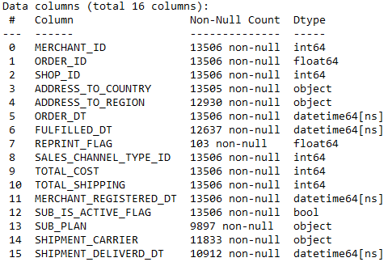
DATA INTRODUCTION
The dataset used for this analysis tracks approximately 13,000 customer orders by slightly above 4,500 merchants from October to December 2020.
Two table were analyzed:
Orders – with the merchant orders attributes
Line-items – with print providers and carrier information

Slide 5
Defining Success At Printify
In this presentation Success is used to measure. It is thus paramount to define what it means for each group as follows:
Merchants – More total successful orders with high revenue
Print Providers – More total printed successfully orders with less printing time.
Shipment Carriers – More total order delivered successfully at low cost and within less time.

Slide 6
Analysis Methodology
For each group, a success metric was derived from data of the core Printify business model attributes and used as the merit to rank the group.
The Business attributes include:
- Revenue realized as it represents the company profits
- Total sales as it represents growth and brand recognition
- Customer experience as it represents reputation and future new and returning clients hence sustainability.

Slide 7
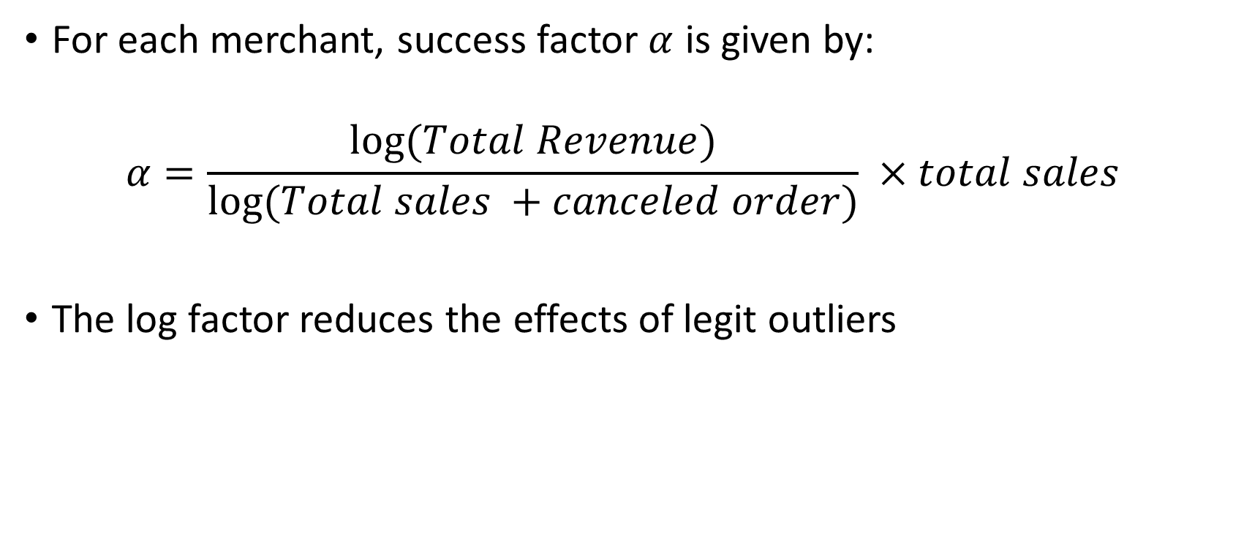
Merchants
For each merchant, success factor $α$ is given by:
$$α=\frac{\log{(Total Revenue})}{\log{(Total sales +canceled order)}} ×total sales$$
The log factor reduces the effects of legit outliers

Slide 8
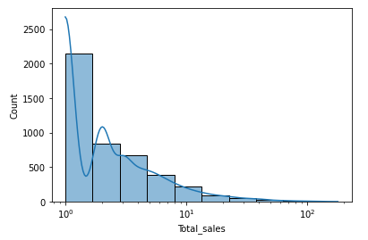
Merchant’s Total sales
Notes:
More sales are low volume. Half normal distribution curve

Slide 9
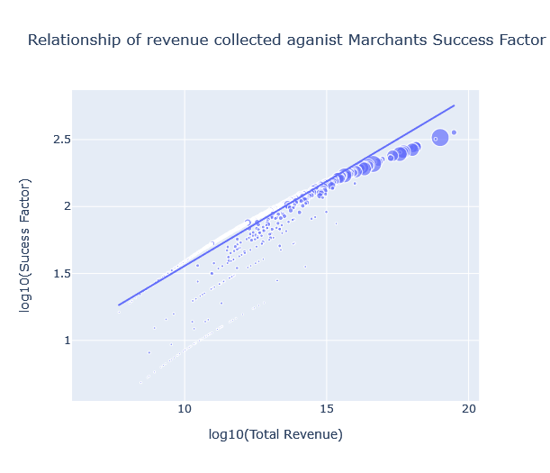
Merchant’s Total revenue and Success factor
Correlation
0.55
Notes:
Introduce correlation: used to measure how strong a relationship is between two variables. Varies from -1 to 1
Introduce a scatter plot: Visualize the relationship of two variables, here with a trendline

Slide 10
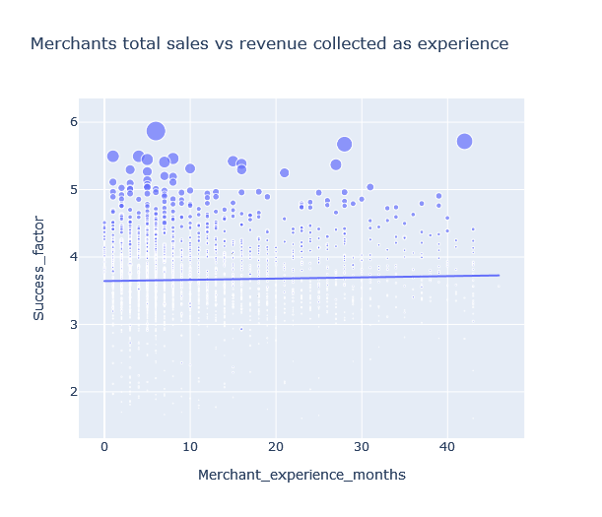
Merchant Success and Experience
Correlation
0.03
Notes:
There is very low correlation between experience and the success for the merchants
Hypothesis here is because of low retention rate for the merchants. Needs proof though

Slide 11
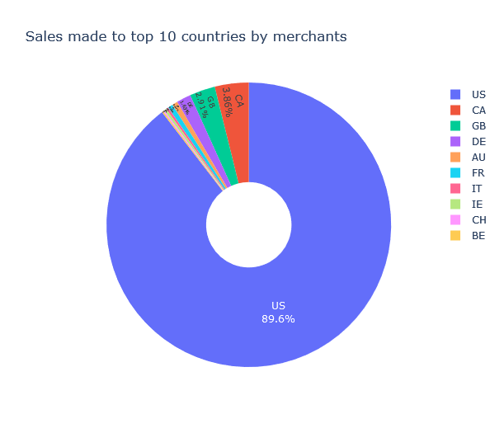
Merchant Success
United States Orders
89.6%
Notes:
More sales are made in US by a margin of 89.9%

Slide 12
Top Merchant Shared Characteristics
Mean Order Revenue
Mean Experience (M)
Mean total Orders
Mean Canceled Orders
€22.13
11
10
2
Popular Product
Popular Country
Popular Brand
Mean Delivered Orders
T-shirt
USA
Gildan
9
Notes:
-They had a mean revenue of 22133.10 cents
-They had a mean total sales of approximately 10 orders
-They delivered a mean approximate of 9 orders
-They had a mean of approximately 2 orders canceled
-The merchants had a mean of 11.2 months
The mostly sell products of the Gildan Brand
Most of them sell T-shirts as their products
They mostly sell to United States end customers¶

Slide 13
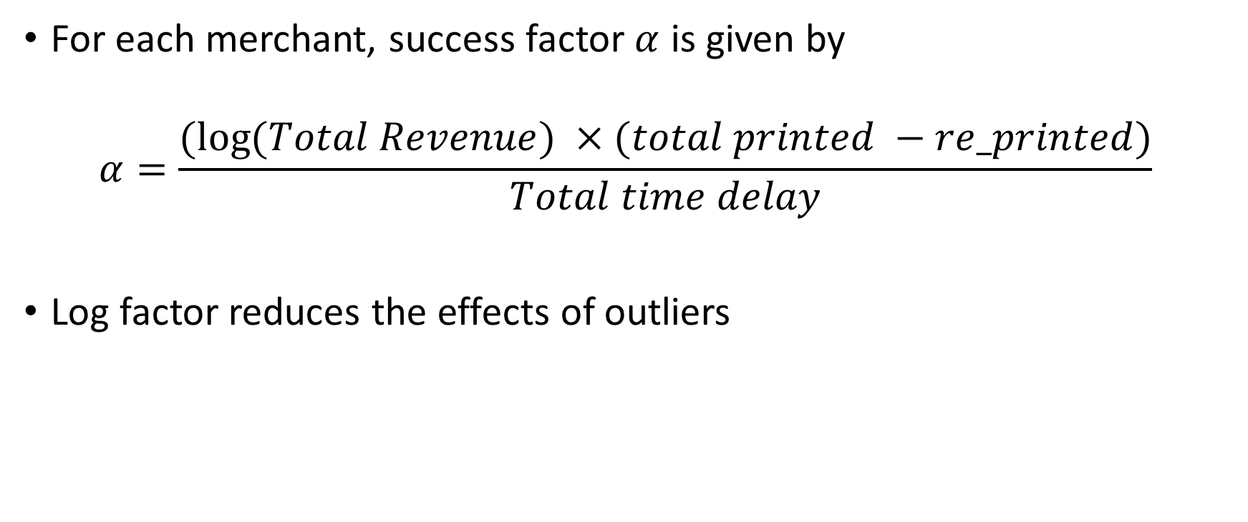
Print Providers
For each merchant, success factor $α$ is given by
$$α=\frac{(log{(Total Revenue}) ×(total printed −re_printed)}{Total time delay}$$
Log factor reduces the effects of outliers
Notes:
Total revenue
Total orders printed
Re-printed orders
Time delay

Slide 14
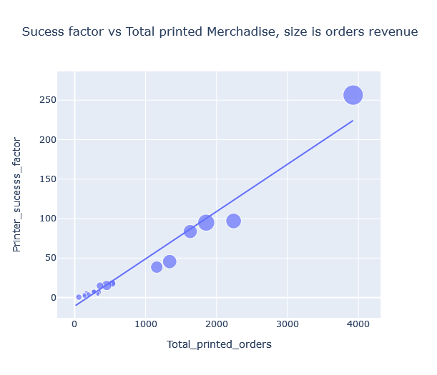
Success Factor and Total Printed Orders
Correlation
0.98

Slide 15
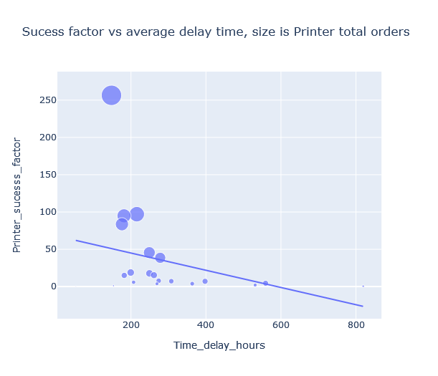
Success Factor and Order Time Delay
Correlation
-0.33
Notes:
The more a printer provider delays an order, the low the success in the metric model

Slide 16
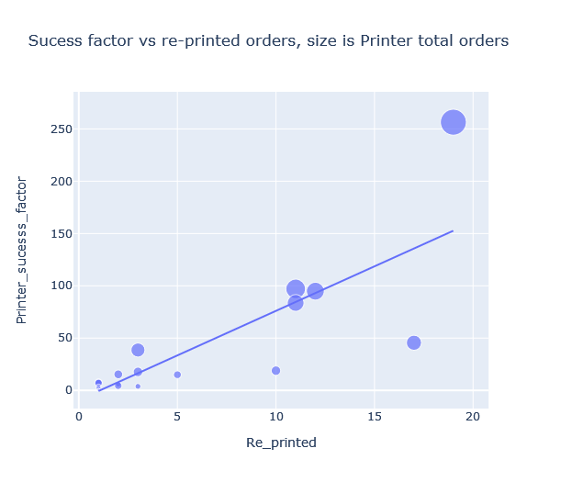

Success Factor and Re-printed Orders
Correlation
0.82
Notes:
Surprising this is true. This is because the number of reprinted order increases by random probability with the amount of orders a printer has printed. The more the orders printed the more the chances of having a reprint flag for an order. Thus in a sense, high number of re-print means high number of orders thus the high correlation.

Slide 17
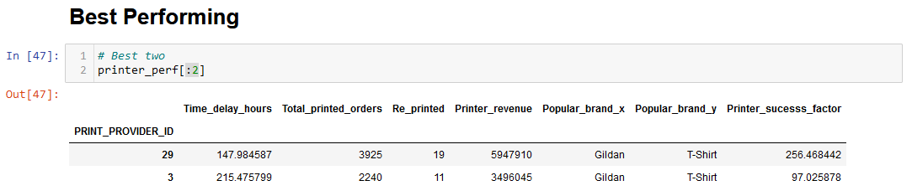
Two Best Print Providers
Based on the criteria outlined above, the following are the best print providers and their attributes: Print provider with ID as 29 and 3.
Recommendation: Provide a discount.

Slide 18
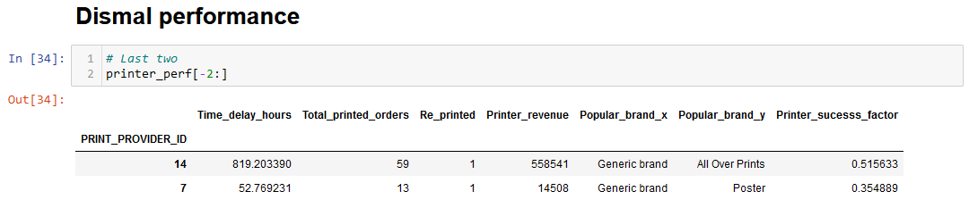
Worst Performing Print Providers
Based on the established success metric, these are the two print providers were found to be performing dismally. Print provider with ID as 14 and 7 with the shown characteristics.
Recommendation: Terminate contract

Slide 19
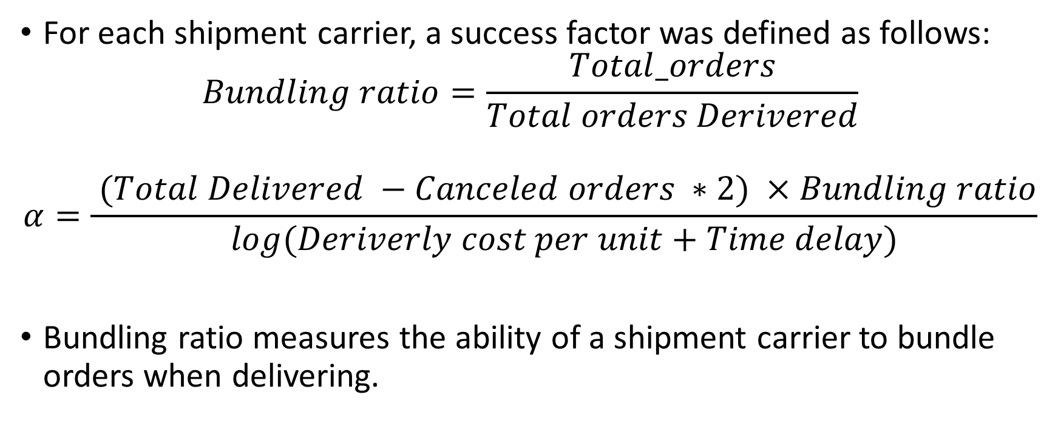
Shipment Carriers
For each shipment carrier, a success factor was defined as follows:
$$Bundling ratio=\frac{Total_orders}{Total orders Derivered}$$
$$α=\frac{{(Total Delivered} −Canceled orders ∗2) ×Bundling ratio}{log(Deriverly cost per unit+Time delay)}$$
Bundling ratio measures the ability of a shipment carrier to bundle orders when delivering.
Notes:
Canceled orders are multiplied by 2 to increase its effect on the success i.e. reduce success factor if canceled orders count is high.
Log factor reduces the effects of outliers in the denominator.

Slide 20
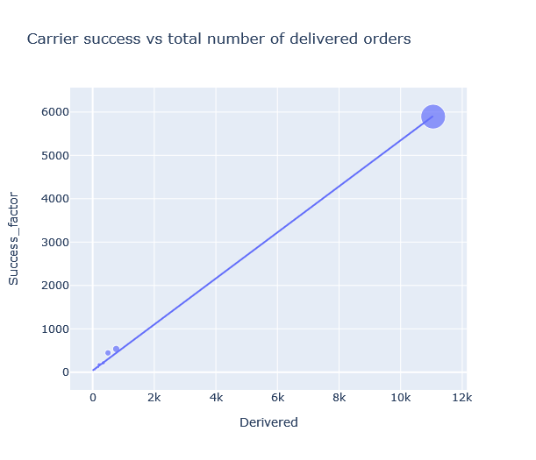
Success factor and Total orders delivered
0.99
Correlation
0.99
Notes:
Very High correlation

Slide 21
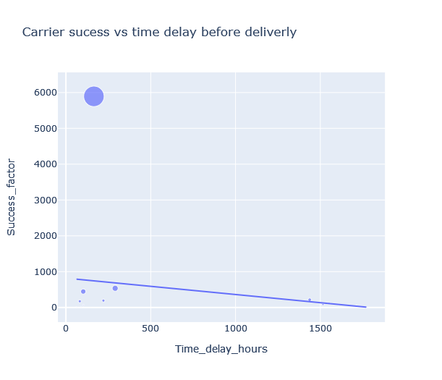
Success Factor and Time delay
Correlation
-0.23
Notes:
The more a shipping company takes long to deliver on average, the less likely they are to succeed according to the Printify metric of shipping carrier discussed above.

Slide 22
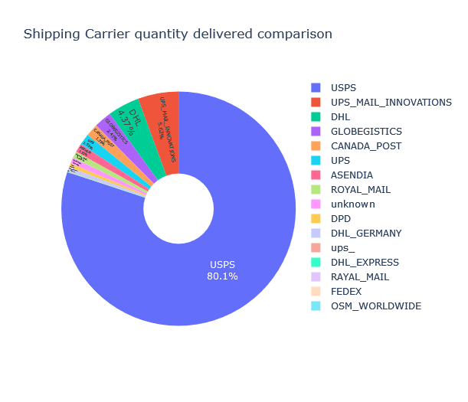
Orders Delivery Quantity Comparison

Slide 23
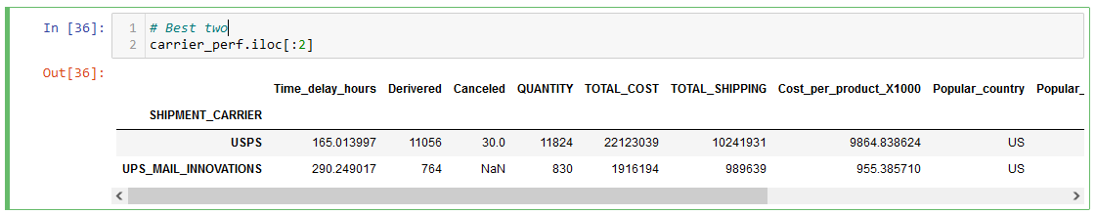
Best two Print Providers
Based on merit of the success factor USPS is by far the most dominant shipping carrier with 80.1%, UPS_MAIL_INNOVATIONS take low ranked second place at 5.6%.
Since the top takes significant share of the market its theoretically effective to use them for all deliveries.

Slide 24
HOWEVER!
The top two shipping carriers mostly:
Deliver only to the United States Printify market
Deliver T-shirts and posters only
Deliver for products from only two print providers 29 and 2
Deliver orders for only merchant 5755049 and 6852170
Thus for Printify to grow and scale up its operations to new markets, increase revenue, promote upcoming stakeholders (merchants and print providers, brands and products) and improve the current operations. Best two should not be the only shipping carriers used.

Slide 25
Why Not to Use Best Two For All Orders
USPS and UPS_MAIL_INNOVATIONS might be the best but other carriers also play a crucial role in the business model of printify.
Having many carrier services increase the geological penetration of printify, making more products available for the customers, and making the print providers more successful which is an advantage to Printify.
Its not a coincidence that US is the biggest market for Printify and the two most successful carriers mostly offer their services there.
A balance should be struck to make all the factors operate at an optimum level i.e. Increase reach to many countries, delivering many orders, delivering many different products in the catalogue, and serving many merchants / print providers.

Slide 26
Thank you Paul Rukwaro

